Slide 1







Online Learning and Progress Tracking System
Efficient SQL Solution s for Simple Online Learning and Progress Tracking System

Slide 2


Introduction
In the age of digital learning, providing personalized learning experiences and tracking student progress are crucial. This Online Learning and Progress Tracking System is designed to enhance the way courses are managed, allowing educators and learners to monitor achievements and motivate ongoing progress.

Slide 3

Key Components of the System
Course Management: A well-defined structure for managing courses and their related lessons.
Student Progress Tracking: Continuous monitoring of each student's progress and lesson completion.
Certificate Issuance: Automatically generates and issues certificates for completed courses.
Leaderboard System: Recognizes top learners, adding a motivating, competitive element through ranking based on course and lesson completion.

Slide 4




Goal
The goal of this system is to support a seamless and engaging learning experience by efficiently managing course materials, tracking individual progress, and celebrating achievements, ultimately empowering students in their learning journey.

Slide 5
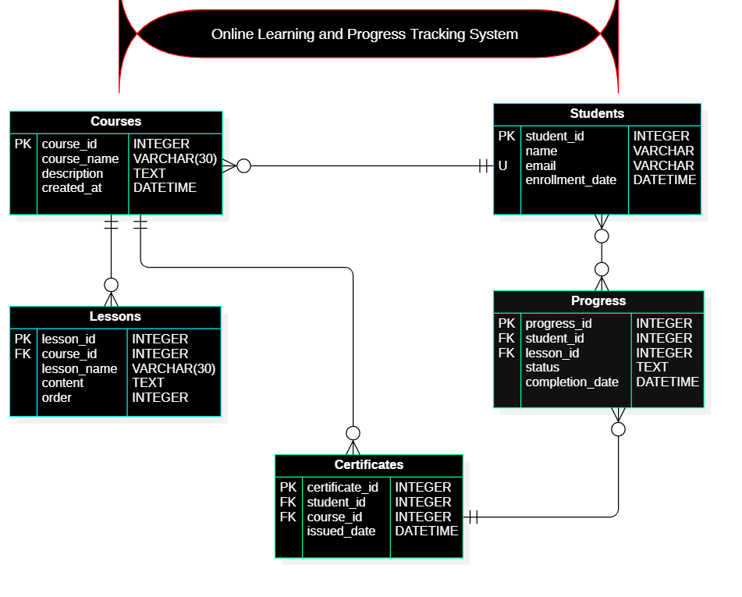
.

Slide 6

Type Of Command
01
03
Data Definition Language
Data Query Language
04
02
Data control Language
Data Manipulation Language
05
Transaction control Language

Slide 7


01
Data Definition Language
Create, Alter, Drop, Describe, Truncate

Slide 8
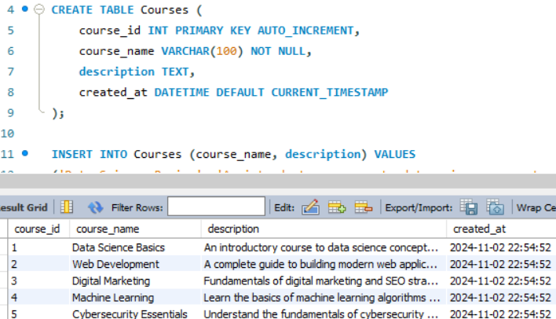
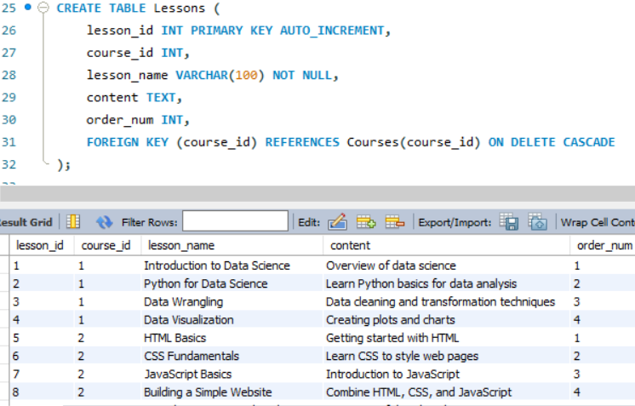
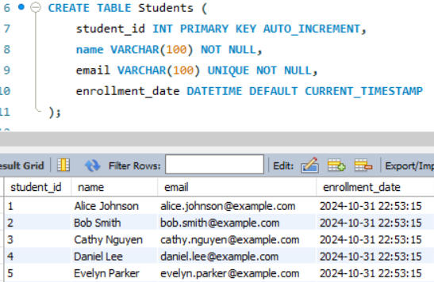

Data Definition Language(Create)
Write the statement to create table with specified Columns & PK
Write the statement to create table with specified Columns, PK & FK
Write the statement to create table with specified columns & PK

Slide 9
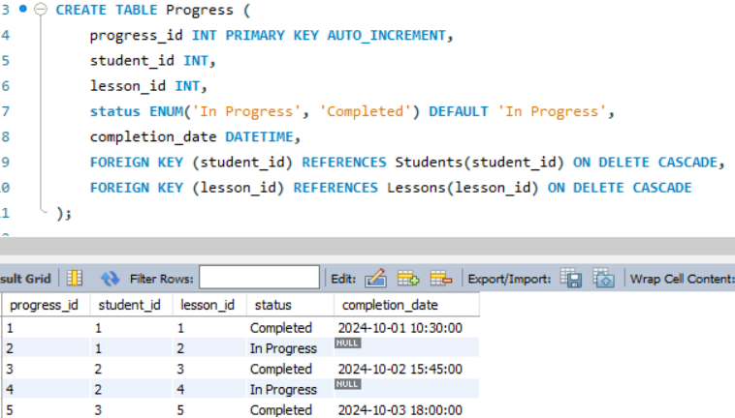
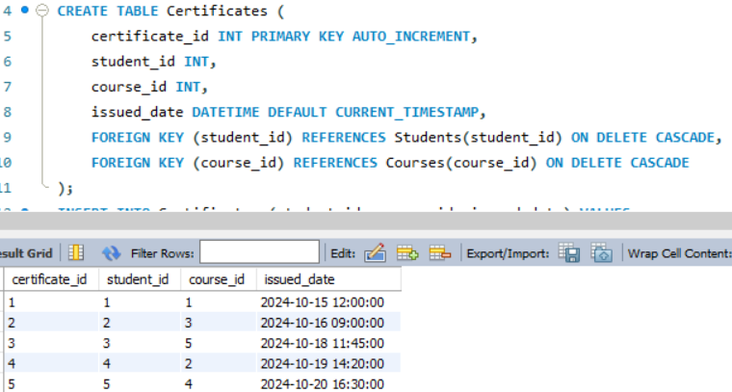
Data Definition Language(Create)
Write the statement to create table with specified Columns, PK & FK
Write the statement to create table with specified columns FK & PK

Slide 10

02
Data Manipulation Language
Insert, Update, Delete

Slide 11

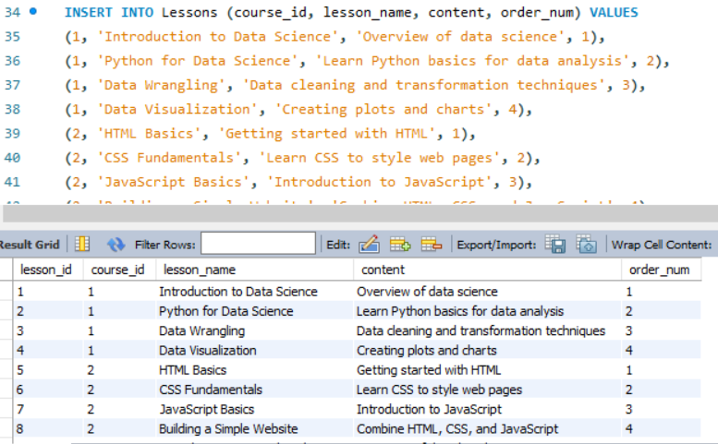
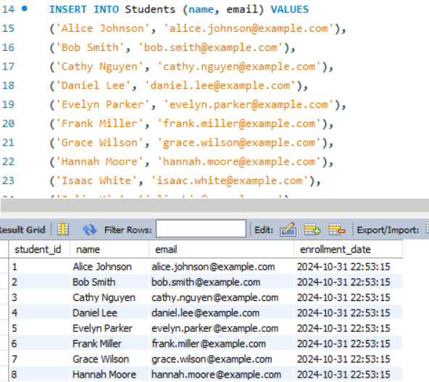

Data Manipulation Language (Insert)
Insert at least 10 records in each table

Slide 12
03
Data Query Language
select, show, help

Slide 13
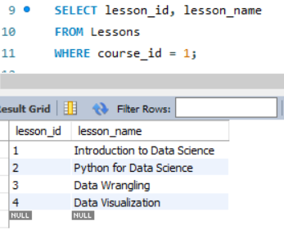
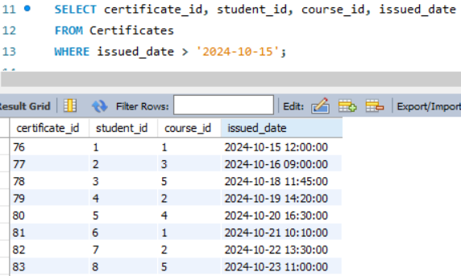
Select & Where Clause
Write query retrieves all lessons for first course
Write query get record of certificates issued after October 15-2024

Slide 14
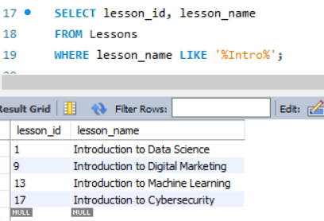
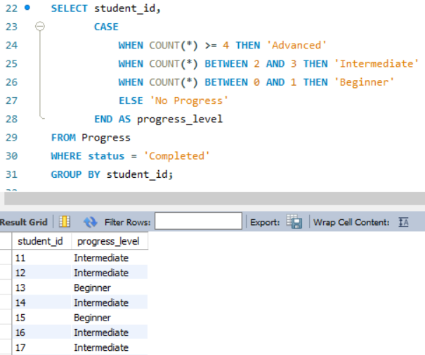
Using Link Operator & Case Statements
Write the query to search for lessons containing "Intro"
WAQ categorizes students based on the number of completed lessons recorded in the Progress table.

Slide 15
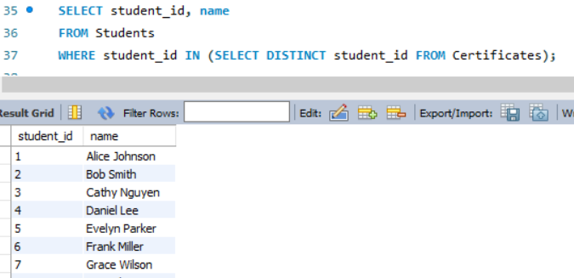
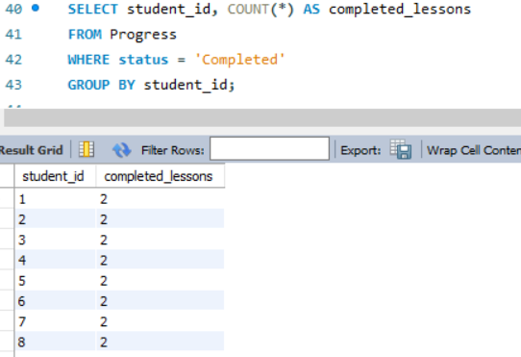
Sub-Query & Group By
Write a Query to Find Students with Certificates
WAQ to find number Lessons Completed by Each Student

Slide 16
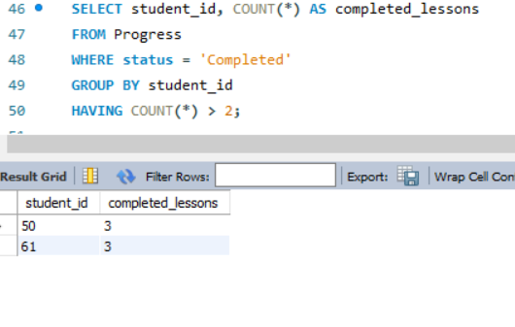
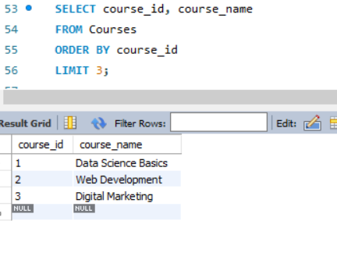
Having Clause & Limit
WAQ to lists students who have completed more than 2 lessons
WAQ to retrieves the first 3 courses sorted by their course_id in ascending order.

Slide 17
JOINS
Left Joins, Right Joins, Full Joins

Slide 18
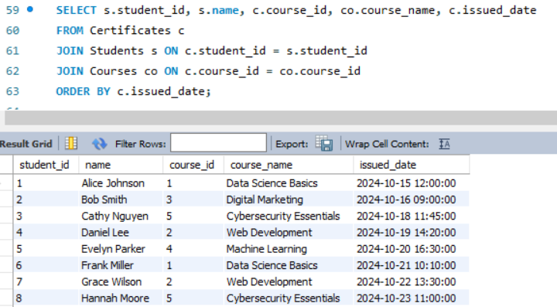
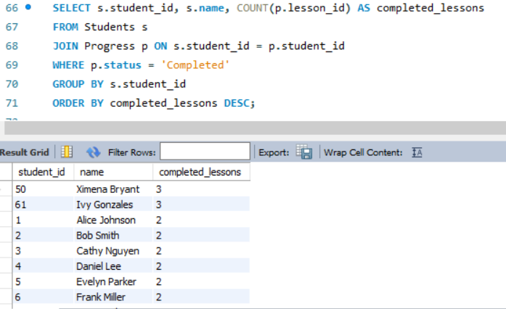

JOINS
WAQ to show Certificates issued for each Student
WAQ to ranks students based on the total number of completed lessons across all courses.

Slide 19
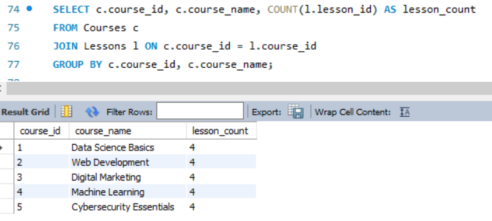
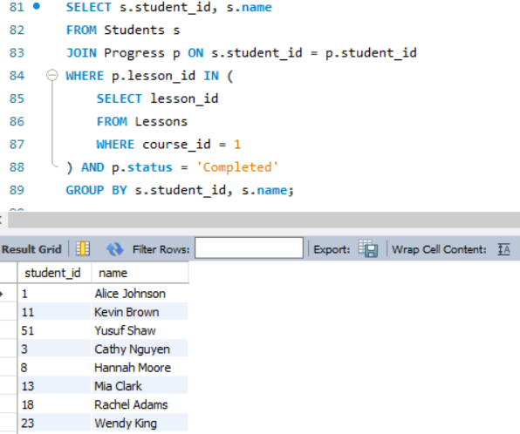
Sub-Query Using JOINS & JOINS with Aggregation
WAQ to shows each course along with the total number of lessons
WAQ to get id and name of students who have completed all lessons for Course ID 1.

Slide 20
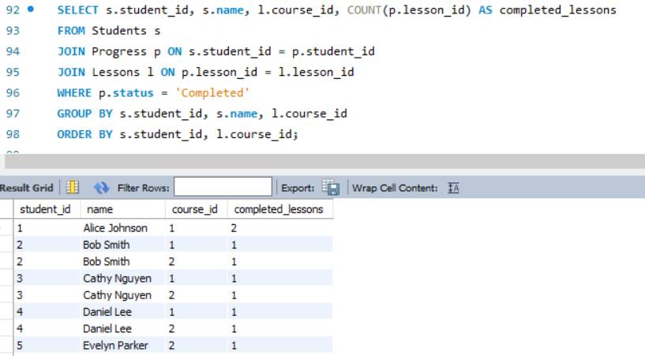
Advanced JOIN
WAQ retrieves each student_id, student_name, course_id, and the number of completed lessons per course.

Slide 21
Conclusion
The Online Learning and Progress Tracking System database project provides an organized and efficient way to manage courses, lessons, students, and their The Online Learning and Progress Tracking System database project provides an organized and efficient way to manage courses, lessons, students, and their
Using MySQL's features like joins, subqueries, aggregate functions, and advanced filtering, we can easily generate insights into students' progress, lesson completion, and course certifications. These queries allow for meaningful data analysis, such as identifying highly engaged students, monitoring lesson completion, and issuing certificates to those who meet course requirements.

Slide 22
THANKS!

